Slide 1
Introduction to Software Business Product management
Week 1 Day 2
Led by: Emily Crose
for
Oakland University

Slide 2

Day 1 recap

Slide 3

Question or clarifications?

Slide 4

Modern software development concepts
Notes:
Today, we’re going to talk at a high level about how modern software is imagined, developed and delivered. We will get into more specifics on this process when we examine the Software Development Life Cycle, but for now, let’s try to visualize exactly how software construction works.

Slide 5

What is a program really?
Notes:
Yesterday, we talked at a high level about what a program is, but we kind of talked about it as if everyone knows exactly what a program is. So let’s ask an obvious question; what is a program really?

Slide 6

Program == code

Slide 7

Code == instructions

Slide 8
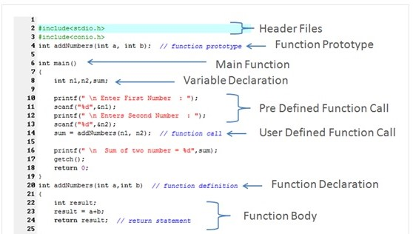
Parts of a program

Slide 9

Scripts vs. binaries
Notes:
We should take a moment to quickly talk about a basic difference between how those instructions we talked about can be built. For most computers, there are two main types of instructions that a computer can consume. There are scripts, and there are “binaries”. What we just looked at in the last slide was a script. If you saw the program in the github, it had a ‘.sh’ extension which means that it’s meant to be run inside of a “shell”.

Slide 10
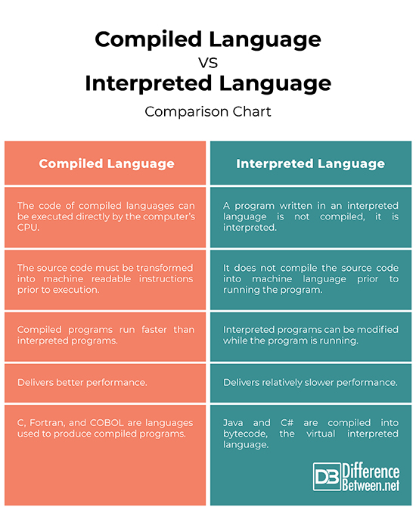

Slide 11
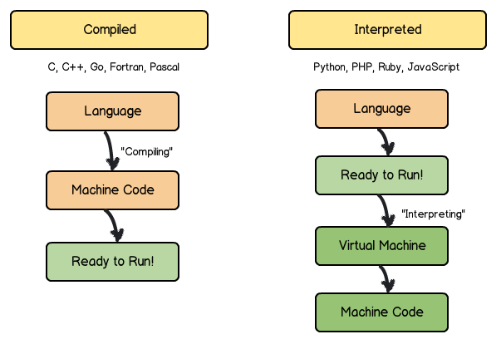
Compiled vs interpreted simplified

Slide 12

Let’s look at some code
https://github.com/hexa-decim8/girltalk/blob/master/girltalk.sh

Slide 13
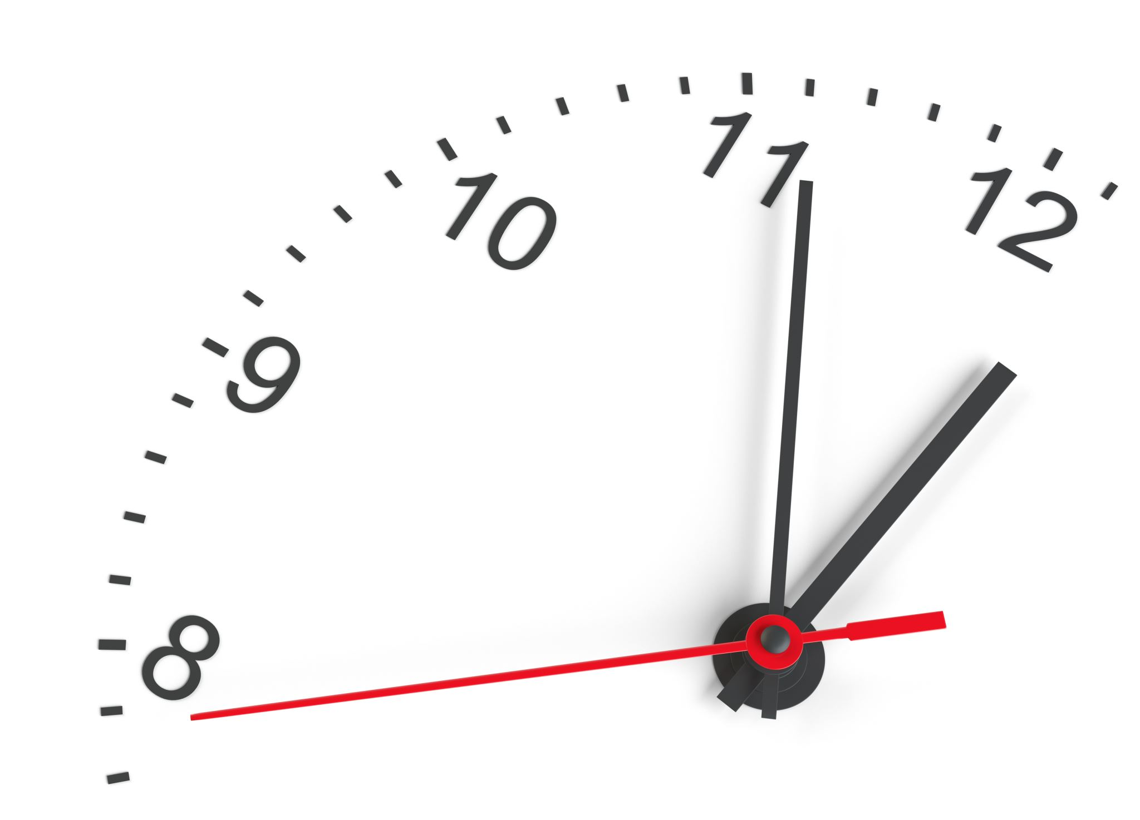
10 minute break

Slide 14

How a program works

Slide 15
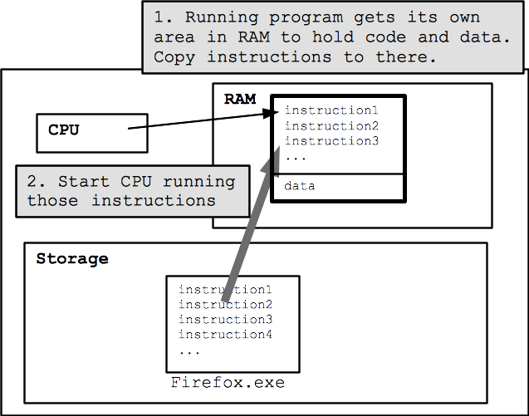
How Firefox works

Slide 16
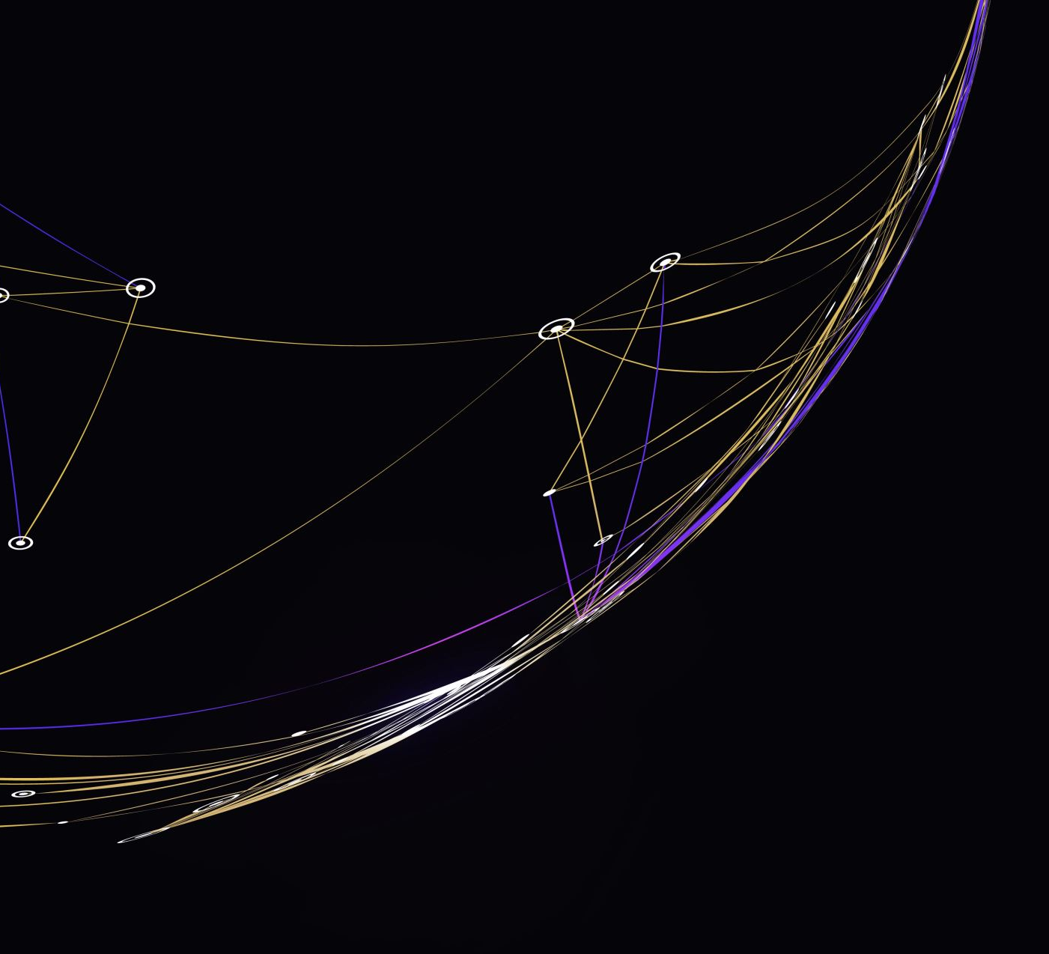
Detailed execution

Slide 17
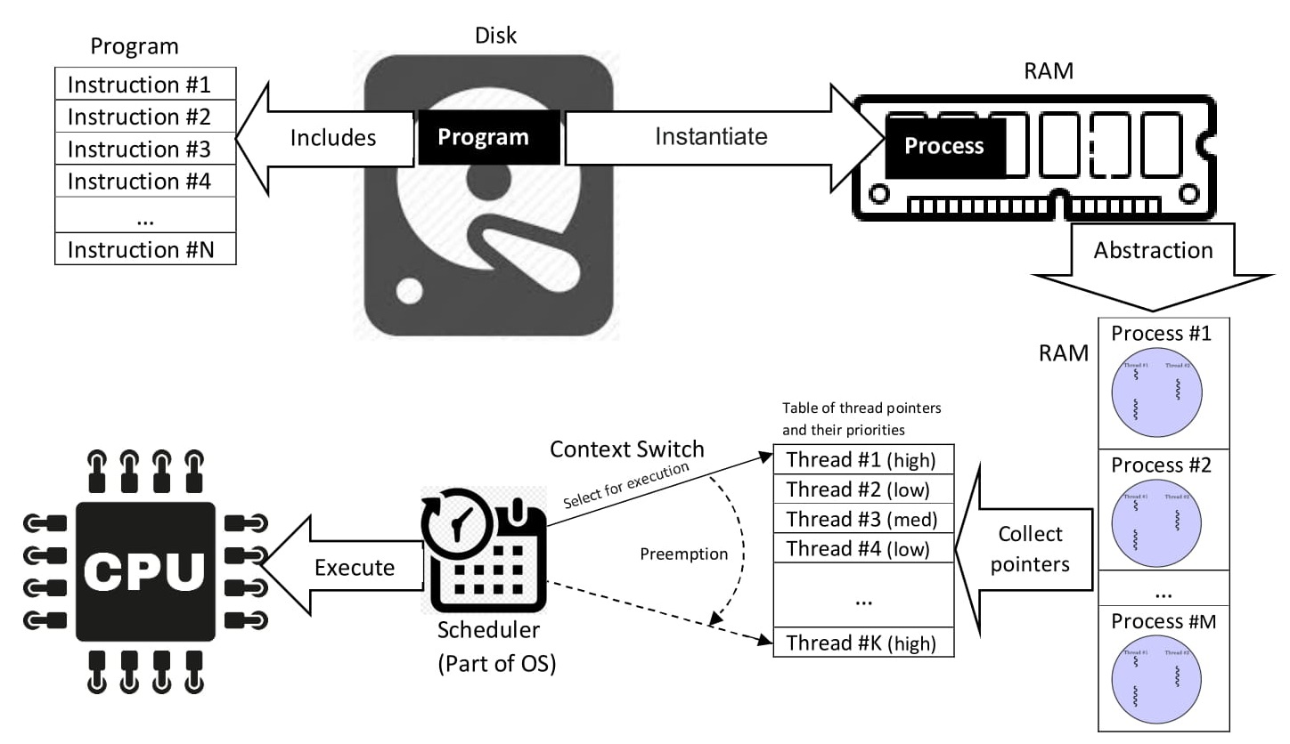

Slide 18
Compiling
What is compiling?
A set of instructions that has been compiled becomes an executable ‘binary’
We may just call this an ‘executable’
Scripts do not compile!

Slide 19
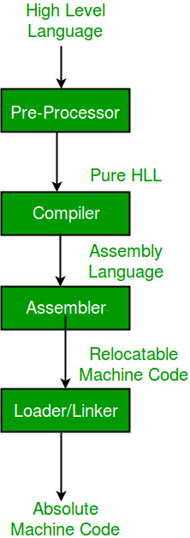
Compile process

Slide 20
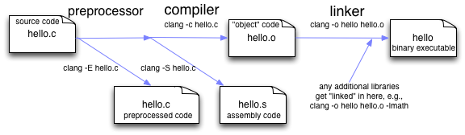
Compiling C in practice

Slide 21

Imagine an outstanding app
Notes:
Everyone nowadays has a smart phone (hardware) and these smart phones have an astounding amount of sensors and wizzbang features on them that apps can use. But as I’m sure we’ve all noticed, not every app is actually all that great. So what I want us all to do for a minute is think about the best app you’ve ever used. Let’s talk about some things that made this app so great to you.

Slide 22

Why would we make an app?
Notes:
You may be wondering why we would want to use software at all to solve any of our problems. The modern world has turned to software largely because of how versatile it is at solving modern problems. It’s not just about entertainment, it’s about letting technology reduce human toil.

Slide 23

How do we build a quality app?

Slide 24

What is the problem?
What problems does this app solve?
How does it solve these problems?

Slide 25

syntheszing a solution
Notes:
We will need to synthesize the solutions we’ve come up with into an app.

Slide 26
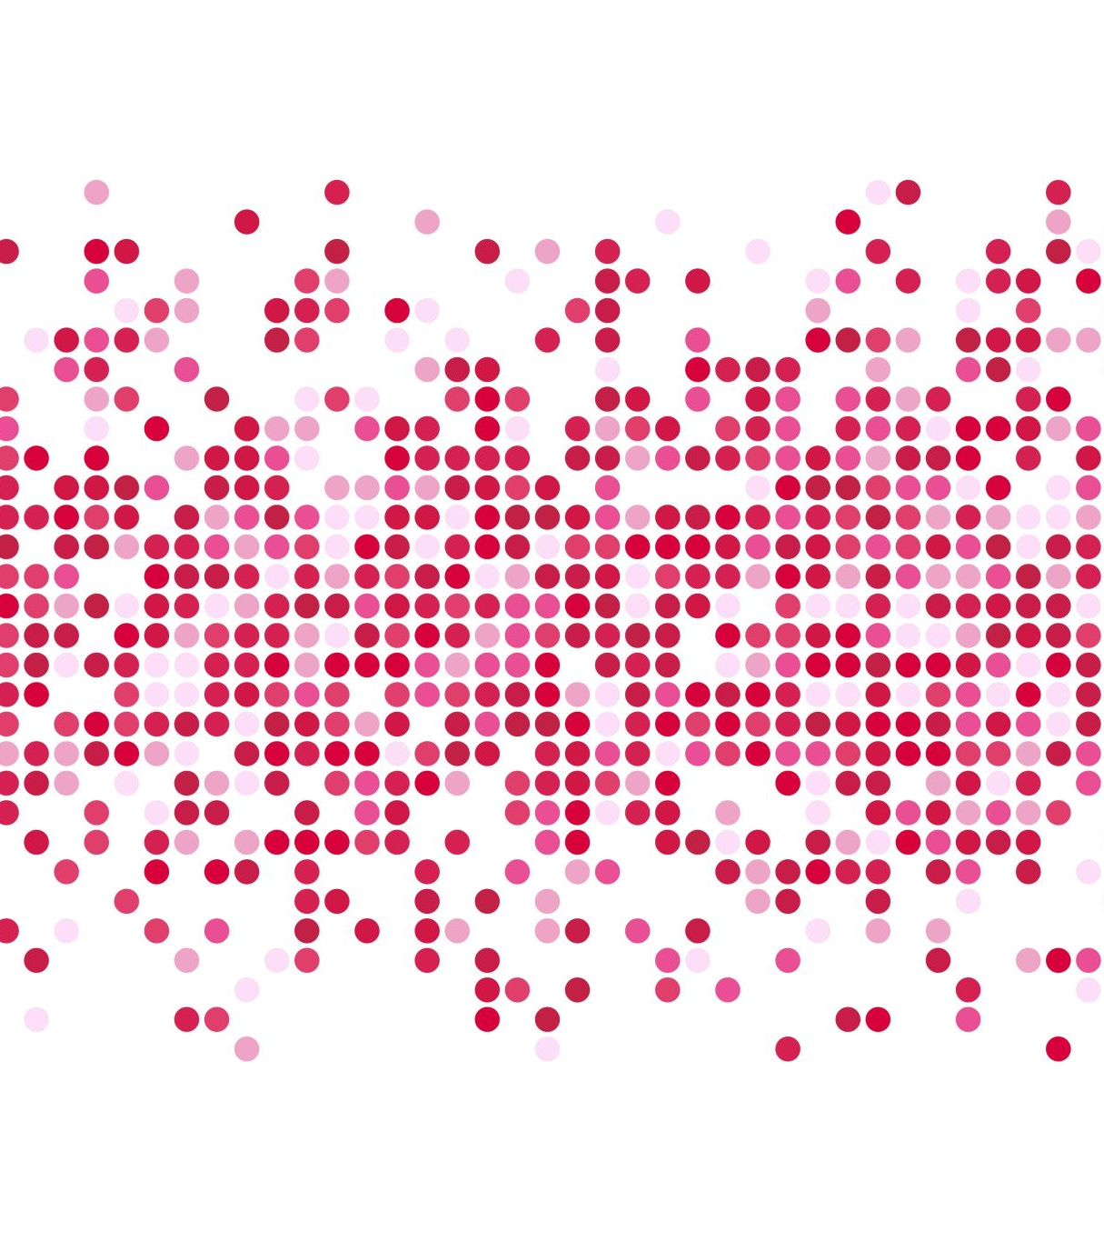
Generating requirements

Slide 27

Who makes software?
Notes:
To make modern software, it takes teams of people. It used to be the case that one rockstar developer could build and market an entire app all on their own. Applications today typically take a lot more people to make a successful application.

Slide 28

Leaders & managers
Notes:
Like any other project, there are leaders and managers involved in the process of creating an application. Generally speaking, project leadership make high level design decisions about how an application should function. This of course is only a small part of the puzzle.

Slide 29

Developers
Notes:
Developers are the lifeblood of executing program design. So when a design choice is made, how that choice gets implemented into the application is passed onto the developers. The “devs” then find the best way of putting the new feature into the program.

Slide 30

“Pseudo”code
Notes:
The exercise of producing “pseudocode” can help solidify concepts into achievable actions which can be programmed and build as an application.

Slide 31

Process flowchart
Notes:
We can also use flowcharts as a tool to outline the way that information is generated and processed by a system. Using tools like pseudocode and flowcharts can help build an idea of exactly how the program will do what it’s supposed to do.

Slide 32

Separation of duties
Notes:
Separation of duties are important for defining exactly how and where processing happens. We will talk more about this topic when we get deeper into technical explanations, but for now, we should be aware that the specifics of how we process information is important.

Slide 33
10 minute break

Slide 34

Testing
Does the code work as expected?
Does the code solve the problem we identified?
What does the code work on?
Does the code function with all of our supported systems?
Do we even know what possible systems exist in the field?
Notes:
When we do our testing, we need to ask a few questions about the app’s functionality.

Slide 35
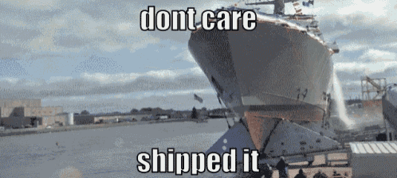
Code distribution

Slide 36
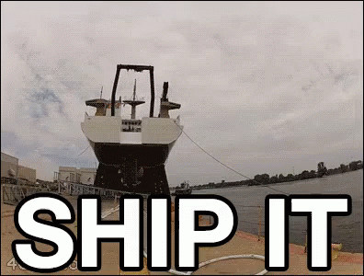
Problem discovery
Notes:
What happens if we discover a problem after we ship the code? What are our options?

Slide 37
Who are our users?
Do we know who they are?
What kind of sensitive information might we be processing?
Personally identifiable information?
HIPAA information?
Legally sensitive?
Notes:
Who are our users? What do they care about? Is there any sensitive information we may be processing that we need to take into account?
Is there a chance that we will run into unforeseen legal governance that will complicate either the way that we process information or store that information.

Slide 38
Supporting those customers
How do our customers contact us?
How do we contact them?
Do we have field support?
What is our process for addressing customer concerns/complains?
What is our process for addressing customer feature requests?
Ticketing system?

Slide 39

Questions?

Slide 40

Review Day 2

Slide 41

Preview day 3

